Slide 1
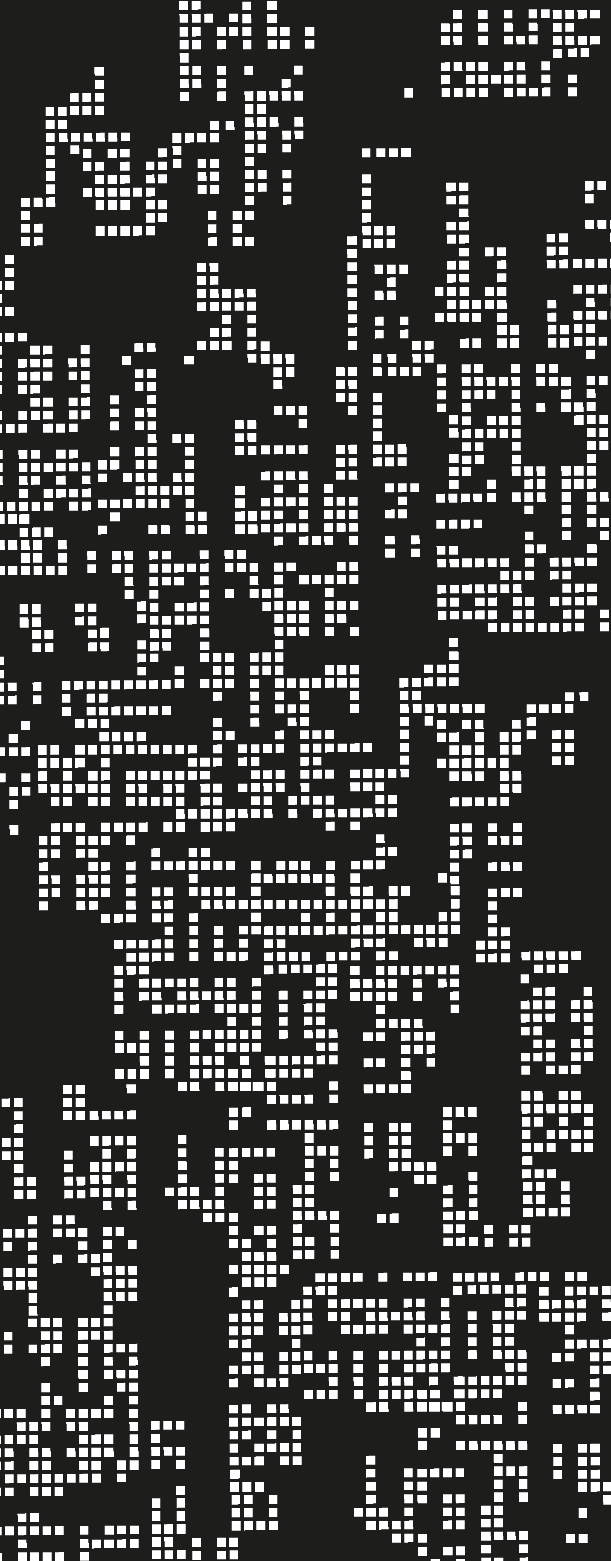
Data Wrangling Findings
S10243668
Law Jun Jie

Slide 2
Table of contents
01
Exploration & Cleansing
02
Transformation
03
Feature Engineer
04
Summary

Slide 3
—Someone Famous
“Garbage in
Garbage out.”
Notes:
In computer science, garbage in, garbage out (GIGO) is the concept that flawed, or nonsense (garbage) input data produces nonsense output.

Slide 4
Exploration & Cleansing
01
Relationships & Missing Data/ Outliers

Slide 5
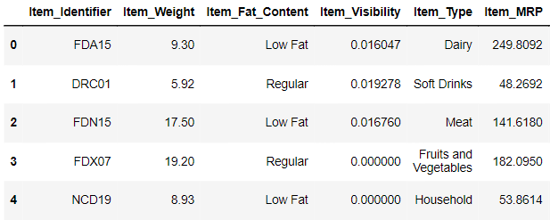
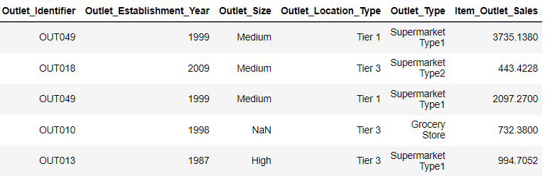
Supermarket Dataset

Slide 6
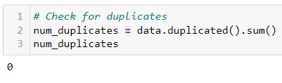
Checking for Duplicates

Slide 7
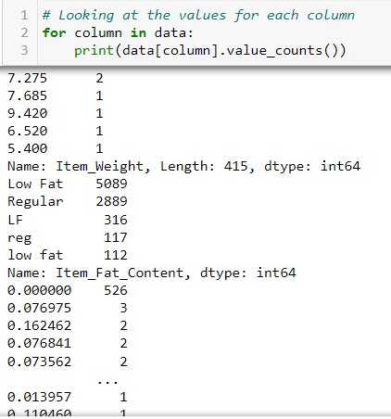
Identifying Inconsistencies

Slide 8
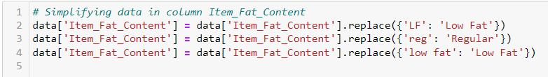
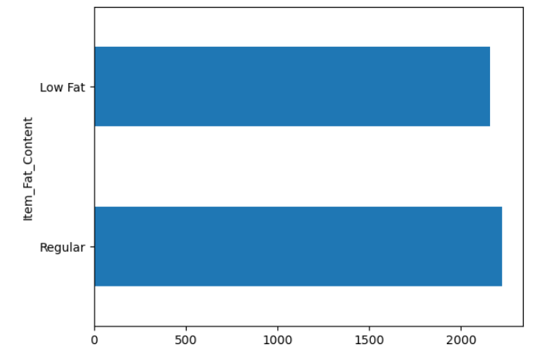
Dealing With Inconsistencies

Slide 9
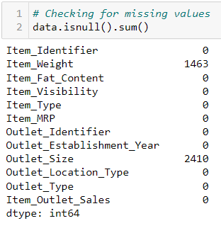
Null Values

Slide 10
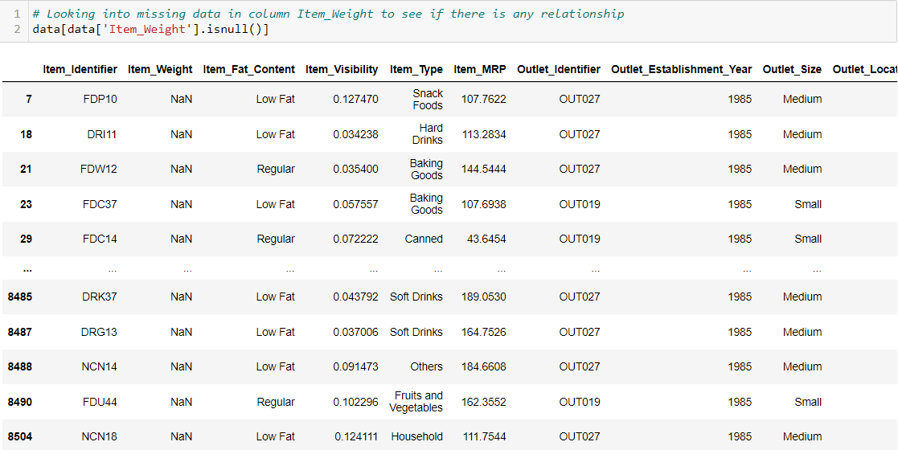
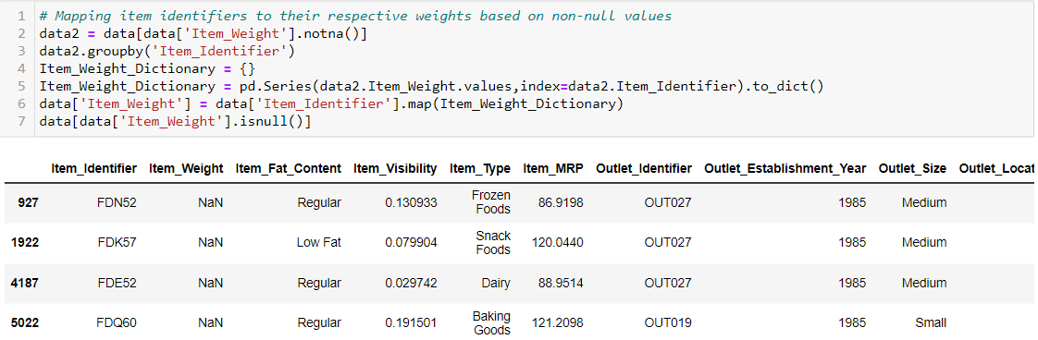
Dealing With Missing Values

Slide 11
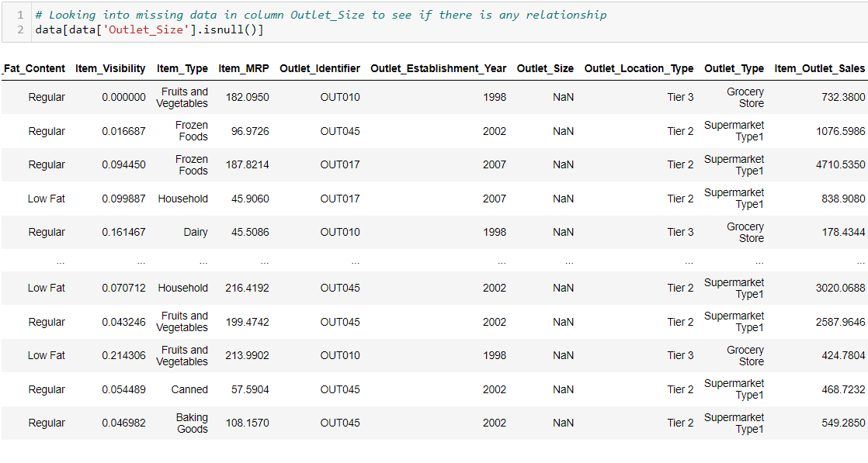
Dealing With Missing Values

Slide 12
Dealing With Missing Values

Slide 13
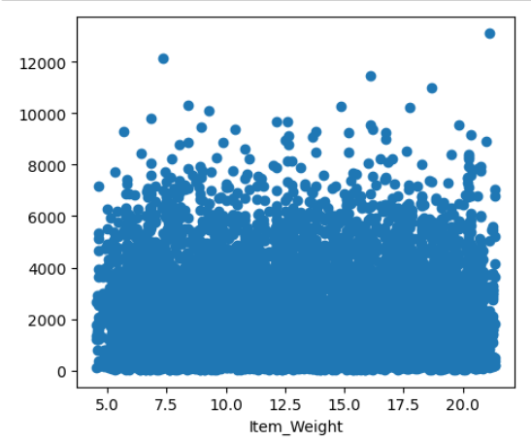
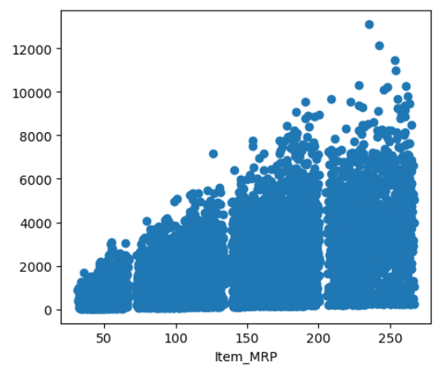
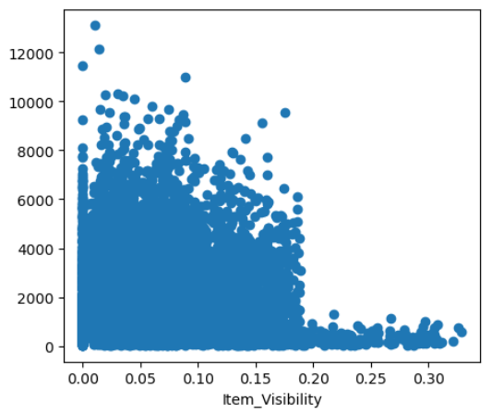
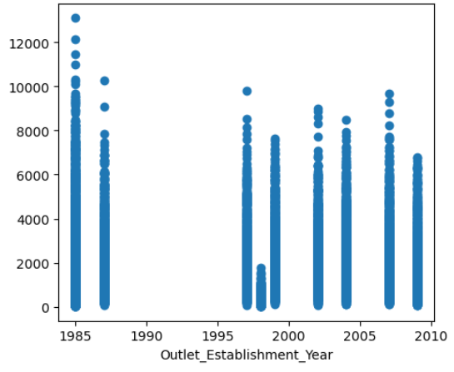
Relationship with Numerical Variables

Slide 14
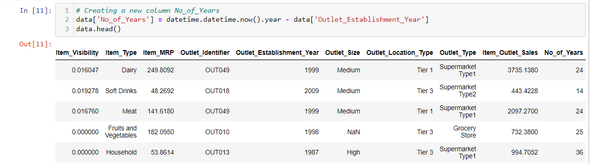

Relationship with Numerical Variables

Slide 15
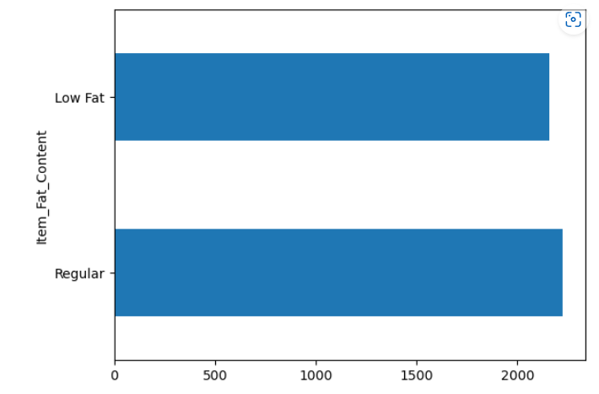

Relationship with Categorical Variables

Slide 16
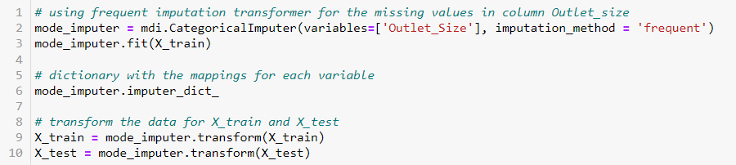
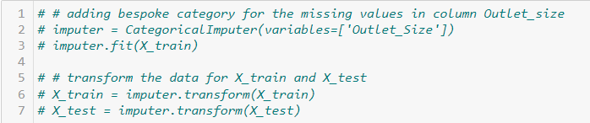
Missing Value Imputation

Slide 17
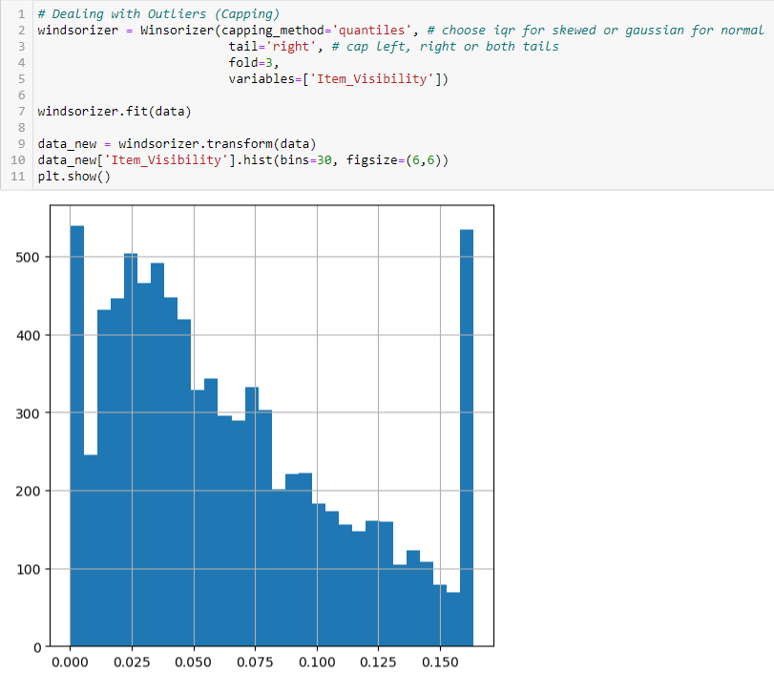
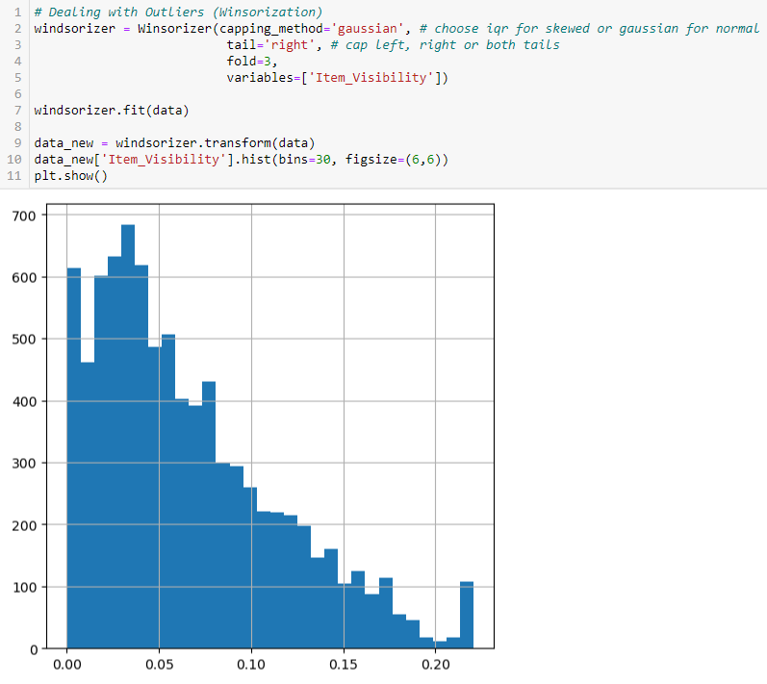
Dealing with outliers

Slide 18
Transformation
02
Categorical Data & Numerical Data

Slide 19
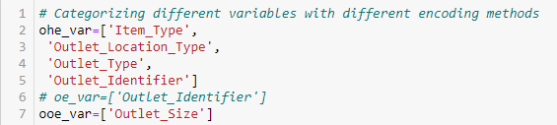
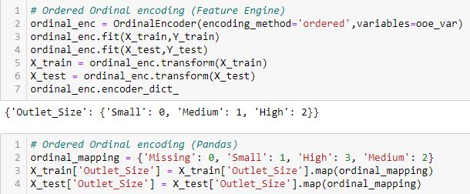
Encoding Categorical Variables
Encoding

Slide 20
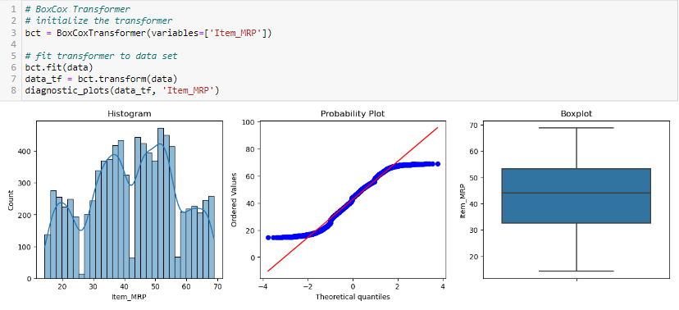
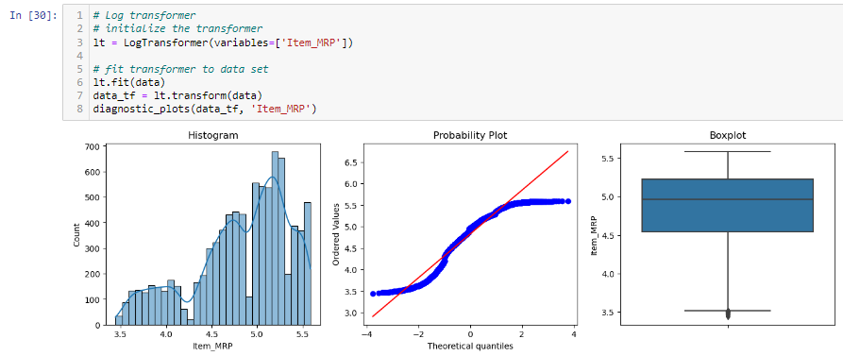
Transforming Numerical Variables

Slide 21
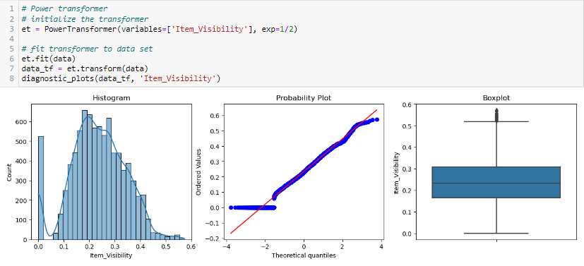
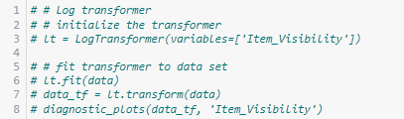
Transforming Numerical Variables

Slide 22
Feature Engineer
03
Feature Scaling &
Create new features

Slide 23
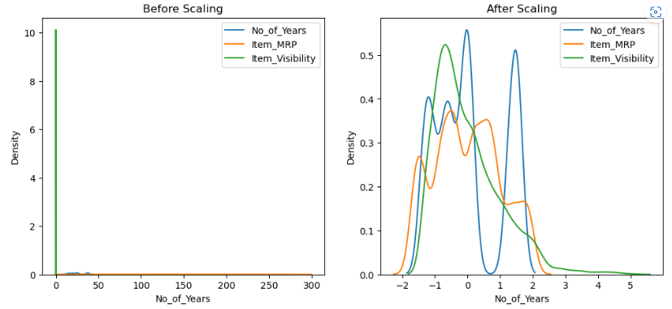
Standardization

Slide 24
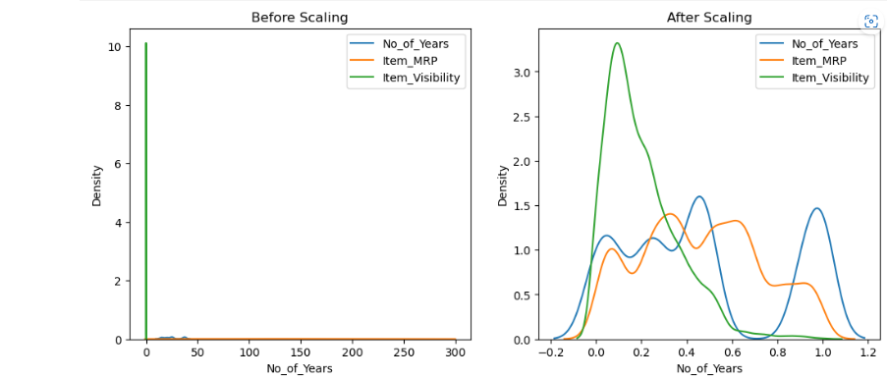
Min Max Scaling

Slide 25
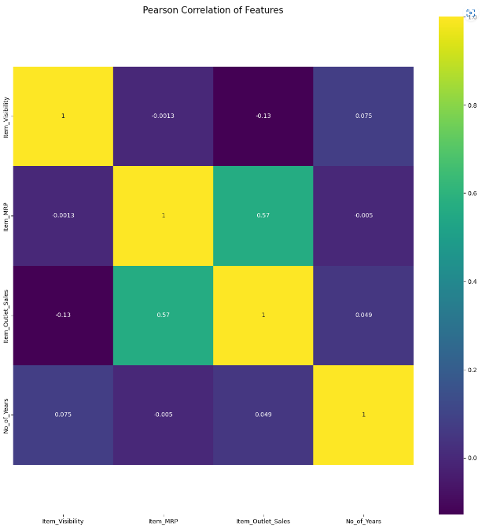
Heatmap
Notes:
To look for correlation between variables

Slide 26
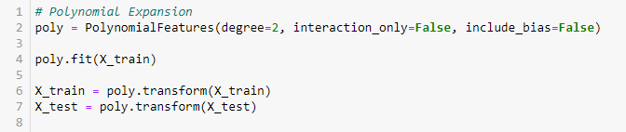
Polynomial Expansion

Slide 27
Summary
04
Evaluate the model & share findings

Slide 28
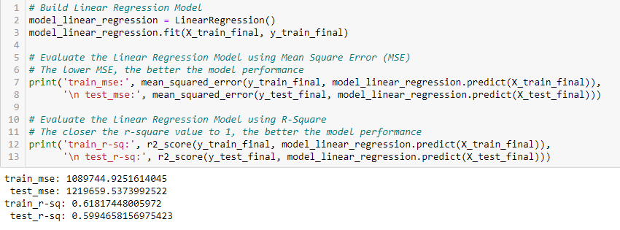
Linear Regression Model
Notes:
To look for correlation between variables

Slide 29
Thanks!
Do you have any questions?
Please keep this slide for attribution

